Slide 1
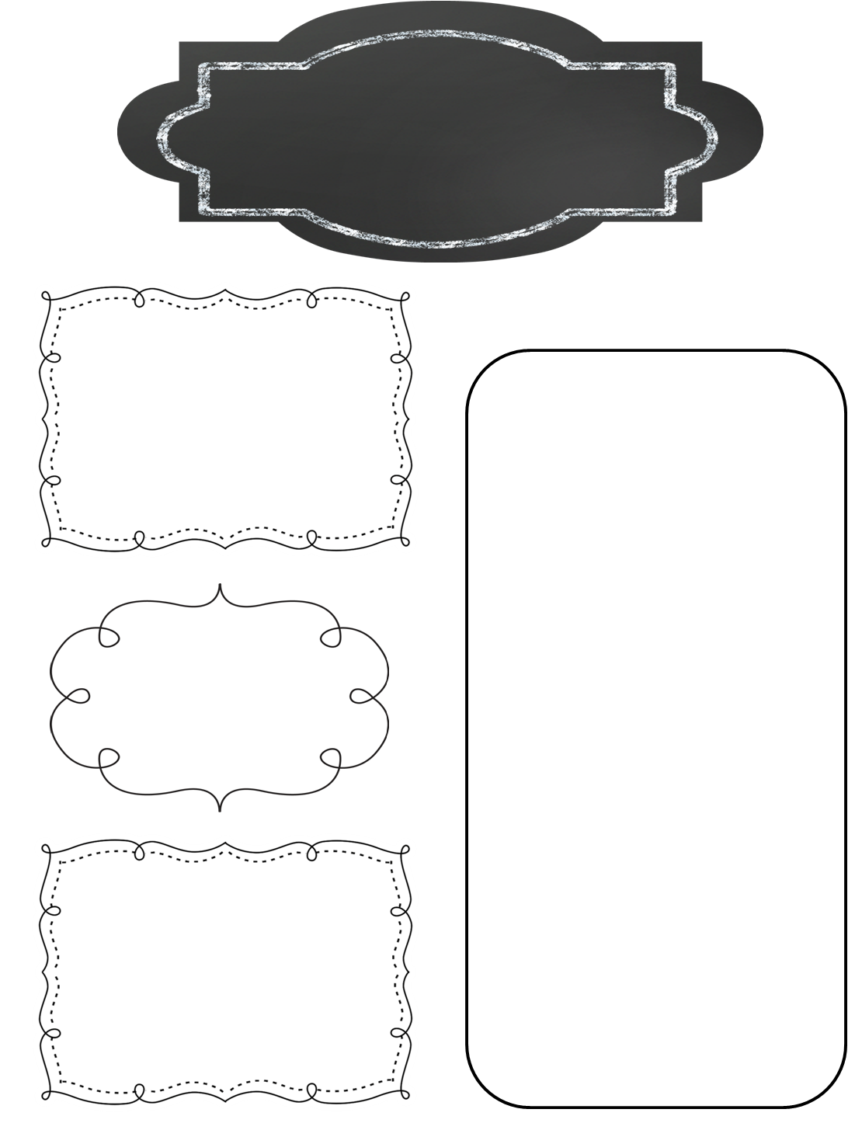
A Peek at This Week in…
Mrs. McFarland’s Class
Week of November 25th
Please continue to help your child review multiplication math facts. We will be having a math fact competition at the beginning of December to compete against other 5th grade homerooms. I hate to say it, but I don’t like losing so let’s get those facts mastered!
Students should continue to read for AR. The deadline is December 19th. Students were assigned individualized points this time.
Reminders
Math (McFarland)
Chapter 12: Geometry
Polygons
Type of triangles
Reading (McFarland)
Compare/contrast writing with two versions of Cinderella
Have a Happy Thanksgiving!
Spelling (McFarland)
Compound words
Test Friday
Upcoming Events
Language Arts/Writing (McFarland)
Tuesday, November 26th: Progress reports go home
Thursday, November 28th: Happy Thanksgiving!!!
Friday, November 29th: NO SCHOOL
Wednesday, December 4-Friday, December 6: Penguin Patch Shop will be open
Friday, December 6th: Math Facts competition time TBA
Compare/contrast writing
Finish narrative writing
Science/ Social Studies (Eldridge)
Science: N/A
Social Studies: Ch. 8 test Tuesday (tomorrow)

